Slide 1
Planning for Surprise
Game-Changers in Big Data Analytics for Healthcare
Carol J. McCall, FSA, MAAA
Chief Strategy Officer, GNS Healthcare
@CarolMcCall

Slide 2
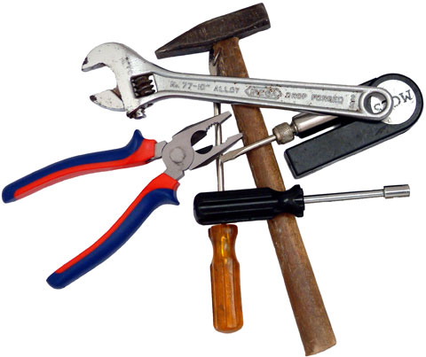
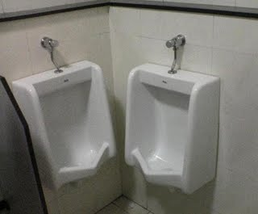
Repair
Re-design
Restore to a previous status
Change an existing situation into a preferred one
2

Slide 3
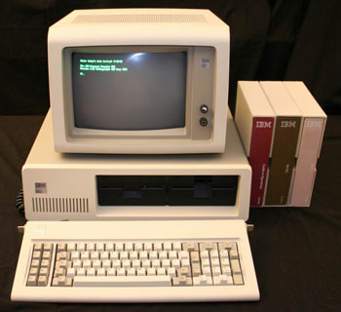

Re-Imagine
Create something brand new that is conceived through a shift in perspective
Like when we re-imagined computers….
Computation
Communication
3

Slide 4
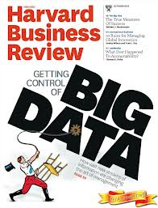
HBR’s Getting Control of Big Data
Less about the scientific and technical challenges
More about its impact on culture and decision-making
The lead article said Big Data would be a “A Management Revolution”
From: What do we think
To: What do we KNOW

Slide 5
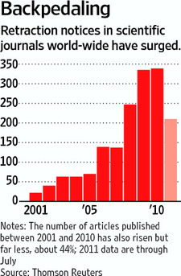
But, Knowing Things is Hard
Retractions are on the rise
Mistakes in Scientific Studies Surge
WSJ August, 2011
When a study is retracted, it can be hard to make its effects go away.
In a sign of the times, a blog called "Retraction Watch" has popped up to monitor the flow
Theories suggested on why the backpedaling?
Journals better at detecting errors
Easier to uncover plagiarism
Competition / temptation for fraud

Slide 6
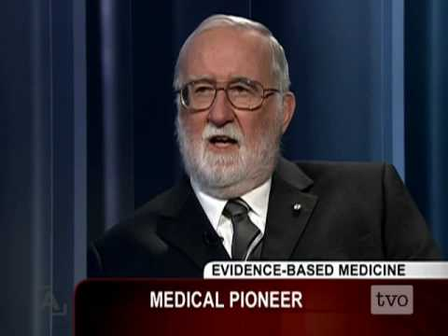
But, Knowing Things is Hard
We Often Turn Out to Be Wrong
Studies of Studies Show We Get Things Wrong
The Guardian, July 2011
Two recent studies analyzed landmark
research on clinical effectiveness
Only ~50% have stood the test of time
Remainder of them have been
  Reversed outright
  Supported, but to a lesser degree
  Inconclusive (or still unchallenged)
“Half of what you’ll learn in medical school will be shown to be either dead wrong or out of date within five years of graduation.”
Dr. David Sackett
1. Prasad V, Gall V, Cifu A. The Frequency of Medical Reversal. Arch Intern Med. 2011;171(18):1675-1676.
2. Ioannidis JP. Contradicted and Initially Stronger Effects in Highly Cited Clinical Research. JAMA. 2005;294(2):218-228.

Slide 7
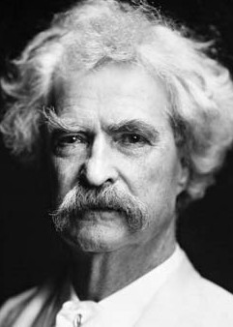
Mark Twain was right
It ain't what you don't know that gets you into trouble.
It's what you know ‘for sure’ that just ain't so.
- Mark Twain
These findings suggest that
There's NEVER an excuse to stop
monitoring outcomes
Such medical reversals, if we pursued them,
could be common
To do that, we need to:
Create ways to find what we’re NOT
actually looking for
Get better at Being Wrong

Slide 8
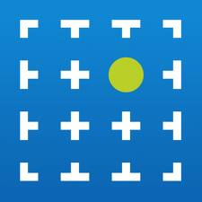
GNS Healthcare
Hypothesis-free discovery
of cause-and-effect relationships directly and at scale
from observational data

Slide 9
An Example of Discovery @ Scale
Planning for Surprise
The Setting
Innovative Healthcare Company
  National research reputation, a portfolio of publications and rich data assets
  Recently published on an important drug-drug interaction
Their Goal
Expand Their Ability to Discover Important Results
  Frustrated by time required; concerned about questions they weren’t asking
  Test GNS approach – Reproduce their finding and explore evidence of other (unasked) impacts
Their Data
3 Years of Detailed Claims Data
  Details with ICD-9, CPT-4 and NDC codes
  Patients relevant to their earlier finding
GNS Challenge
Reproduce Their Finding (while blindfolded)
  Identify causal links between drugs and outcomes
  Data completely blinded (all codes were dummies)

Slide 10
Big Data?
# Patients | 111,641
# Transaction Records | 58,181,059
# Diagnosis Codes | 12,241
# Procedure Codes | 11,174
# Drug Codes (NDC level) | 24,447

Slide 11
Big Data!
# Patients | 111,641
# Transaction Records | 58,181,059
# Diagnosis Codes | 12,241
# Procedure Codes | 11,174
# Drug Codes (NDC level) | 24,447
# Hypotheses with Biasing Driver Variables | 44,690,959,998,504,000
~45 quadrillion hypotheses

Slide 12
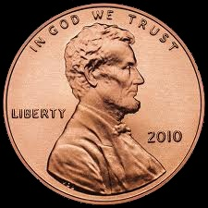
A Penny for Your Thoughts…

Slide 13
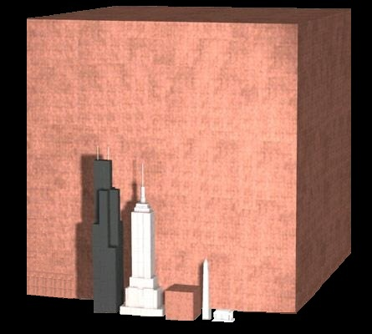
The Hypothesis Space
1 quadrillion pennies

Slide 14
Challenges
Exhaustive search of hypotheses
Preserved uncertainty (probabilistic causality)
Distributed computational load for fast results (in hours)
Modeled time-ordering & interplay of events and exposures
Automatically identified causal drivers and adjusted for bias
The Approach
14

Slide 15

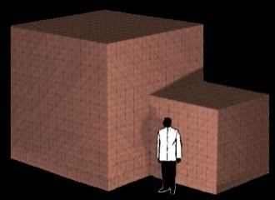
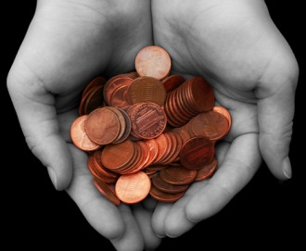
The Results
Hypotheses (45x)
 | Adverse Effects | Beneficial Effects
# Total Hypotheses | 44,690,959,998,504,000
# Detected Correlations* | 31,481,043 | 42,471,231
# Detected Causal Relationships* | 248 | 151
Correlations
* Statistically significant at p=.05
Causal Relationships
Clearly showed the power of the approach
  Reduced the space to the meaningful few
  Reproduced the earlier finding!
Found things we weren’t looking for
  A notable surprise: A possible adverse effect for a commonly prescribed drug
  Initially replicated in (2) out-of-sample datasets
  Pursuing additional validation (no blindfolds this time)
15

Slide 16
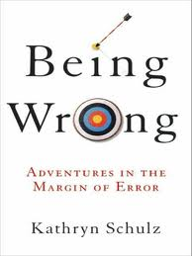
Preparing for Surprise
A fascinating tour of human fallibility
and a new way of looking at wrongness
Schulz sees our capacity to err as inseparable from our imagination
She links error to human creativity, and in particular, to how we generate and revise
our beliefs about the world
With new ways to do this, we can get better
at Being Wrong and just perhaps, unleash
our creativity in healthcare

Slide 17
Thank you
Carol J. McCall, FSA, MAAA
Chief Strategy Officer, GNS Healthcare
@CarolMcCall

